Slide 1
Representing a multiplicative relationship
Task A: Using double number lines
1a)
1
2
3
b)
1
2
3
A
A
B
B
4
8
12
3
6
9
A | B
1 | 4
A | B
1 | 3
For every 1 A, there are 4 Bs.
For every 1 A, there are 3 Bs.
c)
2
4
6
d)
2
4
6
A
A
B
B
7
14
21
5
10
15
A | B
2 | 7
A | B
2 | 5
For every 1 A, there are 3.5 Bs.
For every 1 A, there are 2.5 Bs.
2) Sofia and her dad walk side by side along a straight path. The number of steps are represented by the double number line.
a) Which line represents Sofia’s steps?
Explain how you know.
b) When Sofia has taken 24 steps, how many steps has dad taken?
c) Write the ratio of Sofia’s steps to her dads steps.
S
12
D
8
Sofia must be the top number line as she take more steps compared to her dad.
Doubling the 12 steps for Sofia gives 24 steps, so doubling the 8 gives 16 steps.
12 ÷ 8 = 1.5. For every 1 step Sofia’s Dad makes, Sofia has to do 1.5 steps.

Slide 2
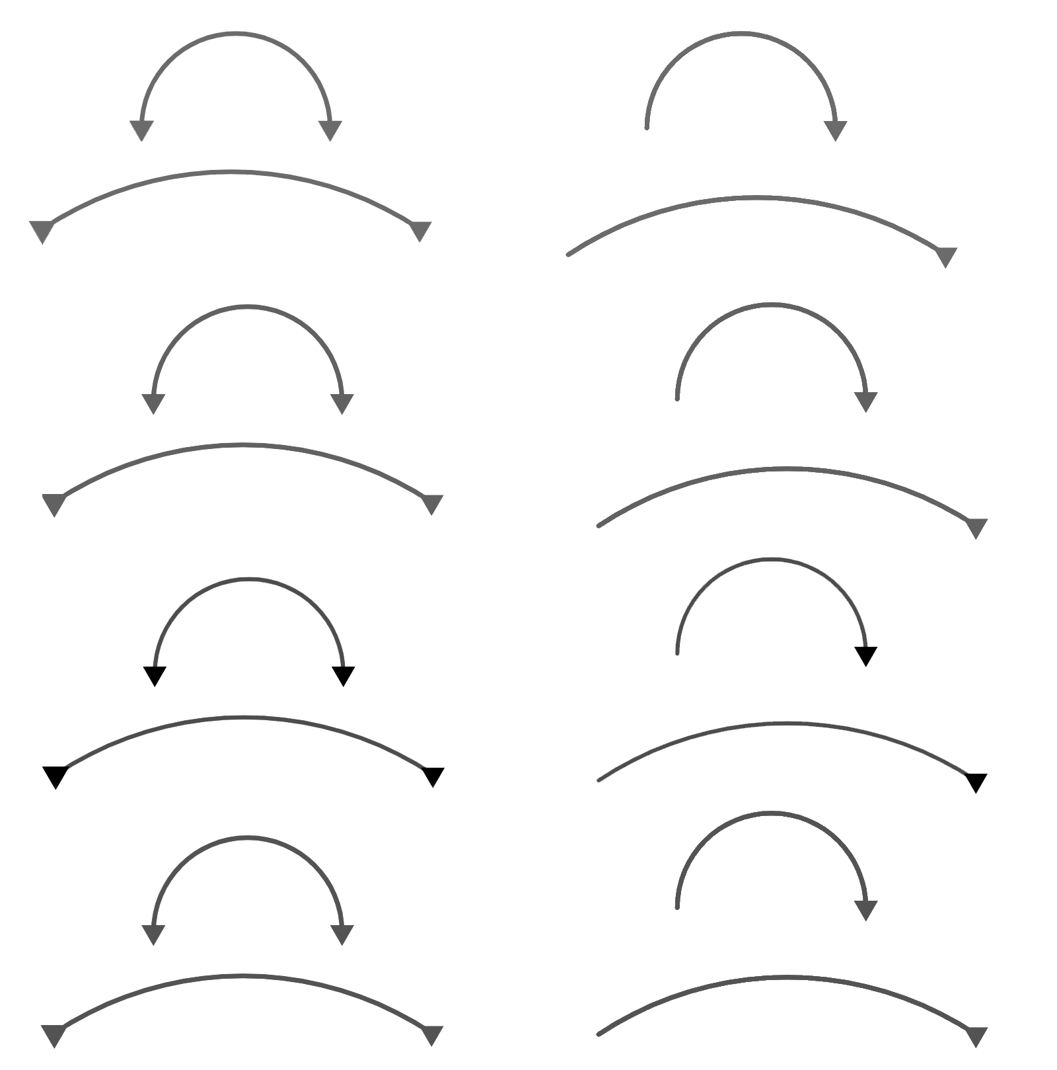

Representing a multiplicative relationship
Task A: Using double number lines
3) Here is a double number line.
Aisha says to find a, she is going to do 5 × 1.5
Andeep says he is going to find one quarter of 30.
Do you agree with Aisha or Andeep? Explain.
10
20
30
A
a
B
5
A | B
20 | 5
30 | 7.5
Both are correct.
Representing this in a ratio table.
× 1.5
× 1.5
4) Fill in the blanks.
a)
3
6
9
b)
10
20
30
A
A
B
B
4.5
9
13.5
3
6
9
A | B
3 | 4.5
A | B
10 | 3
For every 1 A, there are 1.5 Bs.
For every 1 A, there are 0.3 Bs.

Slide 3
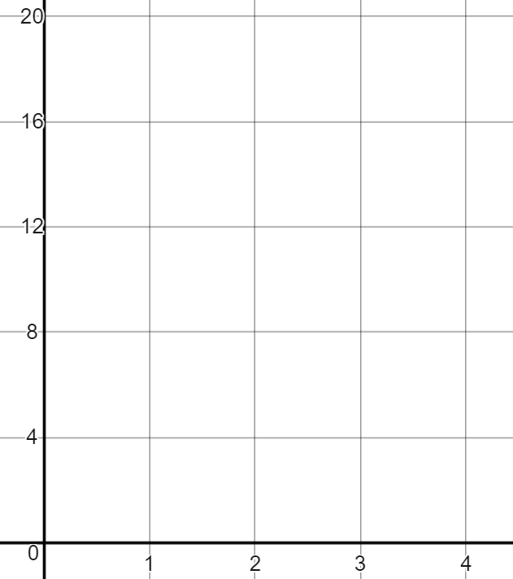
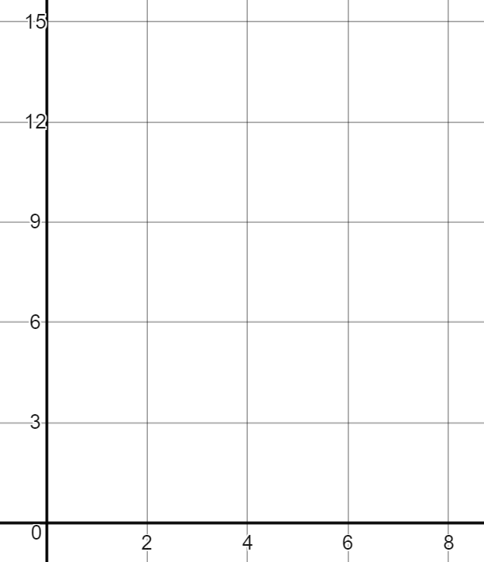
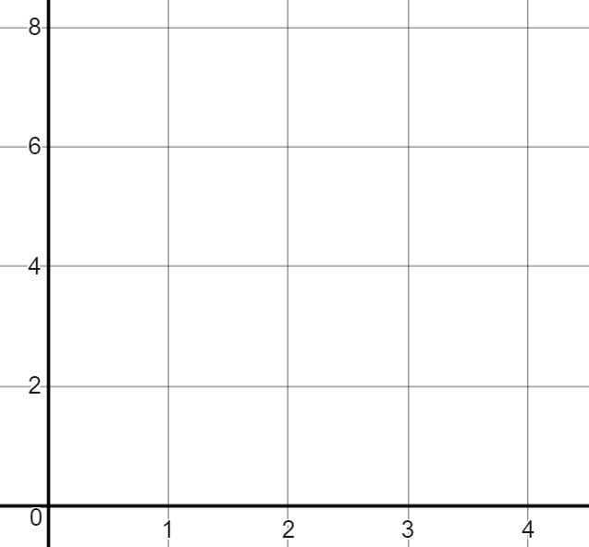
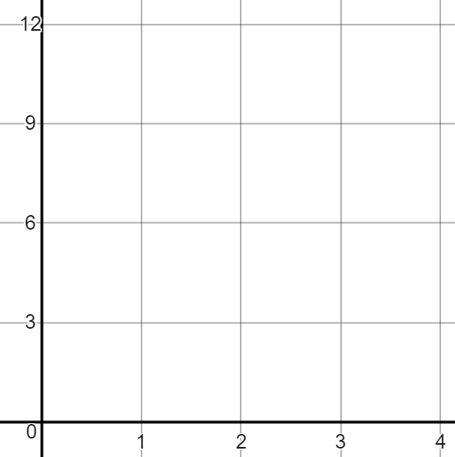
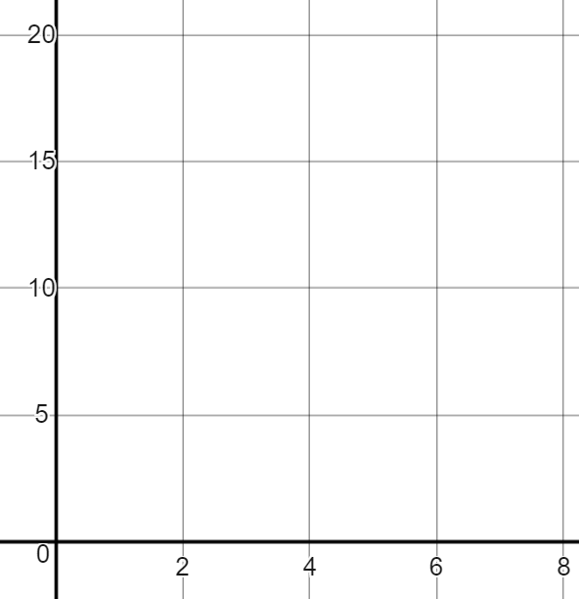
Representing a multiplicative relationship
Task B: Graphical representations
1) Fill in the ratio tables using the corresponding graphs.
B
B
B
A
A
A
A | B
1 | 2
A | B
1 | 8
A | B
2 | 7.5
2) Fill in the missing information on the double number line of graph.
B
B
B
A
A
A
3
6
9
3
6
9
10
20
30
B
B
B
1
2
3
A
2
4
6
A
4
8
12
A

Slide 4
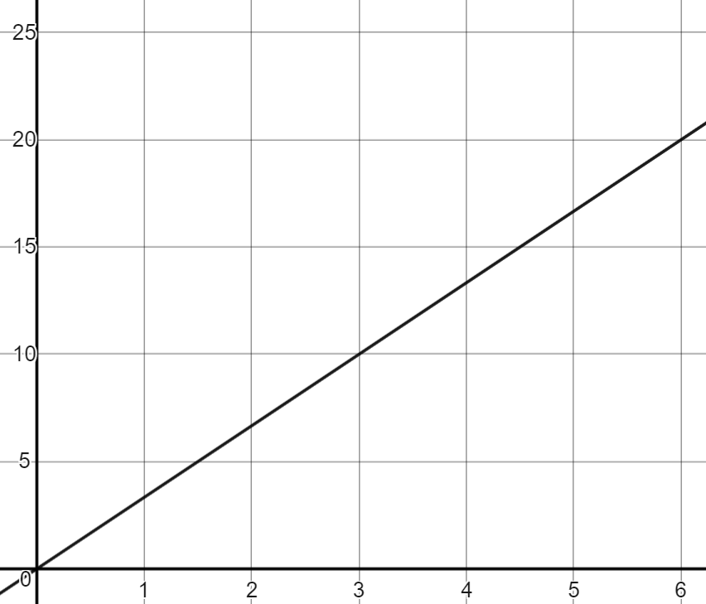
Representing a multiplicative relationship
3) Jacob has interpreted the graph incorrectly.
a) Explain where his mistake is and correctly answer the question.
The double number line is
For every 3 As, there is 1 B
When there are 12 As there are 4 Bs
B
3
6
9
A
1
2
3
B
A
Jacob’s double number line has B as the x-axis and A as the y-axis.
The correct double number line is:
3
6
9
For every 3 As there are 9 Bs
B
1
2
3
A
For every 1 A, there are 3 Bs
4) Fill in missing information and graph when a scale drawing on a map states for every 3 cm is 10 km in real life.
Work out 12 cm in km
Work out 45 cm in km
Work out 60 km in cm
km
Answer: 40 km
Answer: 150 km
÷ 15 means 3 cm for every 10 km
Answer: 18 cm
cm
Mathematics in Education and Industry
v2.3

